Slide 1
Creativity Matters
Options for Creative Careers

Slide 2
CREATIVITY AND THE WORKPLACE
CREATIVITY MATTERS: WHY?
The Overview
WHAT VALUE DOES CREATIVITY HAVE?
CREATIVITY AND ME

Slide 3
How could you define creativity?
”Creativity is the act of turning new and imaginative ideas into reality”
Creativityatwork.com
“Creativeness is the ability to see relationships where none exist.”
Thomas Disch, author, 334, (1974)
“Creativity is the process of bringing something new into being.”
Rollo May, The Courage to Create

Slide 4
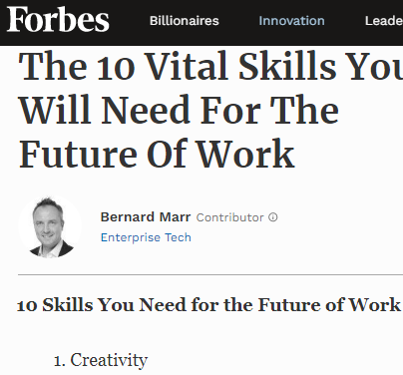
ABOUT 1 In 8 UK BUSINESSES ARE IN CREATIVE INDUSTRIES
Department of Digital, Culture, Media & Sport, (DCMS)
CREATIVITY REGULARLY NAMED BY EMPLOYERS AS ONE OF THE TOP 3 MOST DESIRABLE SKILLS FOR FUTURE JOBS

Slide 5
What are creative industries or workplaces?
Write down 5 areas of business or companies that you think are creative:
1
2
3
4
5

Slide 6
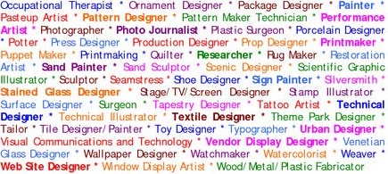
What are Creative Roles?
Notes:
Think about the difference between working in a creative industry and being creative in another sector.
this is by no means an exhaustive list and it’s also important to think about the difference between working in a creative industry and being creative in another sector. For example, you could be a marketing manager for a bank (creative role, financial sector) or an accountant for a theatre (financial role in creative sector).
Creativity involves two processes, thinking and then producing.
talk about all the different types of people you work with.

Slide 7
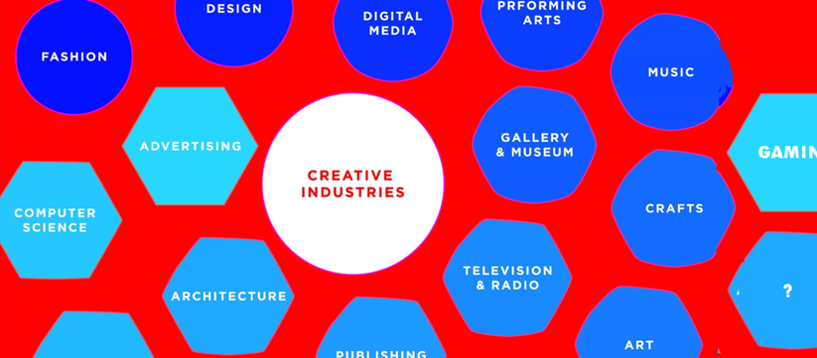
Which area of creativity, do you think makes the most money, in the UK?
1. Music
2. TV & Film
3. IT Software and Games

Slide 8
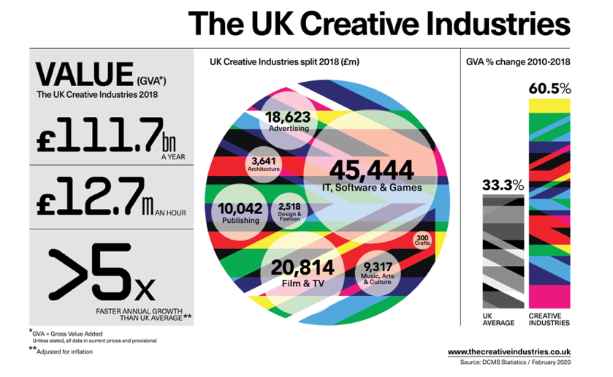
Notes:
The creative industries contribute £111.7 billion a year to the UK economy
That’s £12.7 million an hour!
£45,444 million is generated by the IT, Software and Games industries
£20,814 million is generated by Film and TV
These figures are the most up to date available and are based on 2018 income.
2019 infographics should be available in June https://www.thecreativeindustries.co.uk/resources/infographics

Slide 9
Creative Industries in Waltham Forest…
Waltham Forest has the fastest employment growth in London at 30% compared to London average of 14%
Digital and Creative have been the fastest growing sector in Waltham Forest 40% over 5 years (this exceeds construction, and retail)
Notes:
source: https://www.walthamforest.gov.uk/sites/default/files/Economic_Growth_Strategy_Report_2016_20_0.pdf

Slide 10
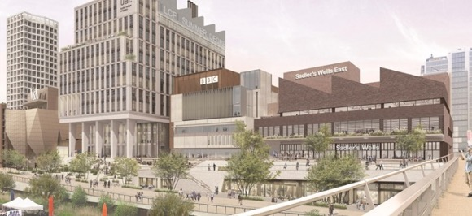
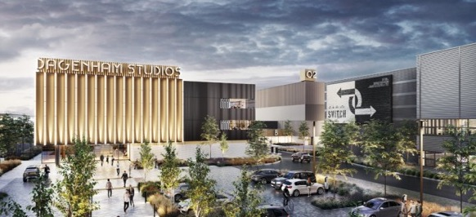
Local creative industry growth…
Dagenham studios – barking & dagenham
EAST BANK - Stratford
Notes:
East Bank will bring an additional 1.5 million visitors to the Park and surrounding area each year
More than 2,500 jobs will be created in East Bank, and an estimated £1.5 billion generation for the local economy
Sadler's Wells East will open a 550-seat theatre and establish a new centre for choreographic practice and a hip hop academy, both of which will be the first of their kind in the country
UAL's London College of Fashion will integrate its six sites onto one campus, accommodating 6,500 students with their world-leading research community, business incubation and social enterpise centres
V&A East will display its world-famous collections at two sites with a new museum at Stratford Waterfront and the V&A Collection and Research at Here East
The Smithsonian Institution will establish a presence in London for the first time ever, in partnership with the V&A
The state of the art BBC music studios will provide a hub from which to celebrate music of all genres
UCL will create a new campus, UCL East, providing multi-disciplinary research, teaching and innovation, in areas such as robotics, smart cities, culture and conservation, for around 4,000 students
DAGENHAM STUDIOS
Planning is underway for new state-of-the-art facility for film and TV production The planned studios will feature six sound stages covering 140,000 sq. ft., 85,200 sq. ft. of offices and 174,500 sq. ft. of workshops.
https://variety.com/2020/artisans/news/dagenham-studios-1203525920/

Slide 11
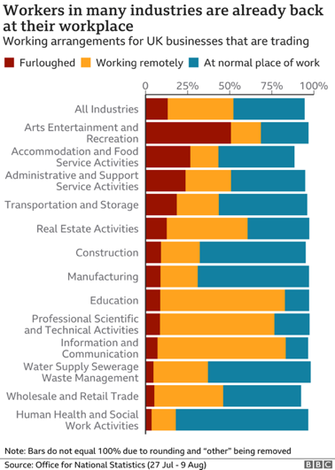
What impact has Covid-19 had?
Live events
Virtual experiences

Slide 12
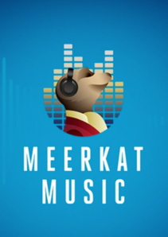
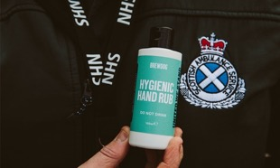
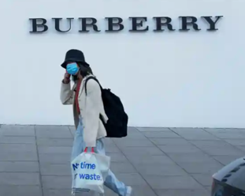
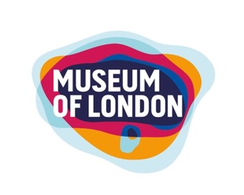
Notes:
All businesses have had to respond to the global pandemic. Here are some examples of their responses.
1. Pivot for Good – where organisations changed their production to help
Alcoholic drinks companies, eg Brewdog making hand sanitizer.
Burberry making PPE
2. Rethinking business model – Where organisations had to adapt and change their offering
Osolocal2u was set up in March 2020 to provide a home delivery service of Fresh Food during the COVID-19 pandemic.
Home deliveries are brought to you by 4DegreesC Ltd, established in 1984. 4DegreesC supply top eateries throughout London and the South East from BRC accredited, refrigerated warehouses in New Spitalfields Market, London and Southampton with a shiny fleet of FORS accredited lorries.
https://www.osolocal2u.com/pages/about-us
3. Virtual world
Virtual museum experiences – Museum of London – Great Fire of London Live Stream
https://www.museumoflondon.org.uk/families/great-fire-london-live-stream
Virtual Museum tours https://www.museumoflondon.org.uk/families/fun-home/virtual-tour-victorian-walk
Meerkat Music – Live stream performances from Take That and Little Mix
Virtual Orchestra – free outreach for young musicians, to give them a chance to play in an ensemble. Started with 60 musicians, now has over 3,500 registered participants across the globe.

Slide 13
Arts and Culture:
more important to people now than ever
Notes:
Whilst being deprived of the opportunity to mix with other people, to experience live events, music and theatre, people have turned to alterative ways to get their culture fix. Bricks-and-mortar-based businesses have suffered, while ecommerce, social media and streaming services have hit the boom time as people have been forced to stay at home.
People have become more acutely aware of how important arts and culture is to them.
As students return after extended periods of disrupted schooling due to COVID-19, arts subjects are at risk of being downgraded in importance in the curriculum. While it’s important that core subjects such as Maths and English are given they attention they deserve, giving young people the opportunity to engage with creative has the potential to help them cope with the challenges around returning to school at such an uncertain time.

Slide 14
What might the recovery of the cultural and heritage sector look like?
+£1.57bn
> £18m
&
+ £2m
Notes:
It’s clear that the Performing and live arts are suffering more than any other sector, but their value to society is being appreciated all the more by its absence. Therefore it’s essential that the cultural and heritage sector is protected for future generations. In July the government announce a £1.57 billion investment to help to do urgent and critical work secure the survival of the industry.
https://www.artscouncil.org.uk/blog/delivering-governments-culture-recovery-fund
In addition Arts Council England have an Emergency Response Package which they will use to build on the government’s rescue package.
ACE have re-opened National Lottery Project Grants, increasing the budget by £18 million to make £75 million available to individuals, community and cultural organisations.
Developing Your Creative Practice - reopening this to help creatives step up their work in new ways, and increasing the budget from £3.6 million to £18 million.
Plus an extra £2 million to support the work of freelancers in the sector.
Museums and Galleries
There has been gradual reopening throughout the summer. Tate Modern - 70% fewer visitors than before the pandemic distanced through queues, timed tickets.
Performing arts
Lots of possible variations have been suggested: take it outside, downsize it, spread it out, stream it. Could you stage a drive-through opera? Could a composer write a work for a socially distant ensemble? Can you make an online literary festival attractive to audiences when they can’t be in the same room as the authors?
https://www.theguardian.com/commentisfree/2020/may/18/war-arts-stronger-covid-19-devastated-theatres-museums-imagination
It’s clear that the Performing and live arts are suffering more than any other sector, but their value to society is being appreciated all the more by its absence. Therefore it’s essential that the cultural and heritage sector is protected for future generations. In July the government announce a £1.57 billion investment to help to do urgent and critical work secure the survival of the industry.
https://www.artscouncil.org.uk/blog/delivering-governments-culture-recovery-fund
In addition Arts Council England have an Emergency Response Package which they will use to build on the government’s rescue package.
ACE have re-opened National Lottery Project Grants, increasing the budget by £18 million to make £75 million available to individuals, community and cultural organisations.
Developing Your Creative Practice - reopening this to help creatives step up their work in new ways, and increasing the budget from £3.6 million to £18 million.
Plus an extra £2 million to support the work of freelancers in the sector.
https://www.artscouncil.org.uk/covid19
Additional reading
https://www.creativereview.co.uk/landing-page/creativity-in-the-age-of-coronavirus/

Slide 15
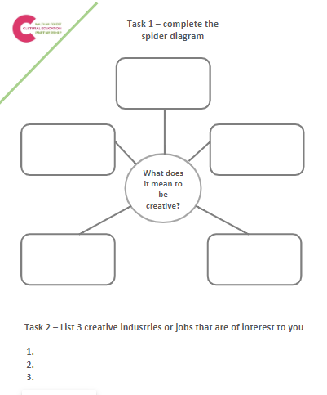
After Class Task
Using the worksheet that your teacher/tutor will share:
What does it mean to be creative?
List three creative industry jobs that interest you?

Slide 16
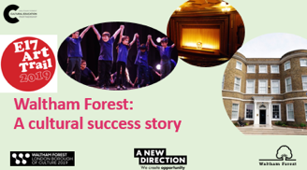
NEXT in the
Creative Careers Tutorial series
Local Success Stories: People and Business
Education Routes into Creative Careers
Professional Pathways in Creative Careers

Slide 17
#Letsnavigate
Options for
Creative Careers

